Slide 1

Computational Methods for Quantum Many-Body Systems (CMQMB) -
from artificial atoms to high-temperature superconductors
Lecture 1 – Introduction
Prof. Dr. Thomas Schäfer Università degli studi di Trieste (UNITS), Winter Semester 2025

Slide 2

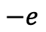
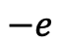
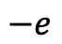
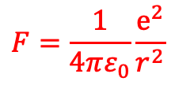
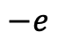
Fascinating physics from electron-electron interactions
→ repulsion
Classical electrostatics:
Coulomb force
$$−e$$
$$−e$$
$$F=\frac{1}{4πε_{0}}\frac{e^{2}}{r^{2}}$$
But Coulomb interaction can also lead to an (effective) attraction!
$$−e$$
$$−e$$
→ Cooper pairs and
superconductors

Slide 3
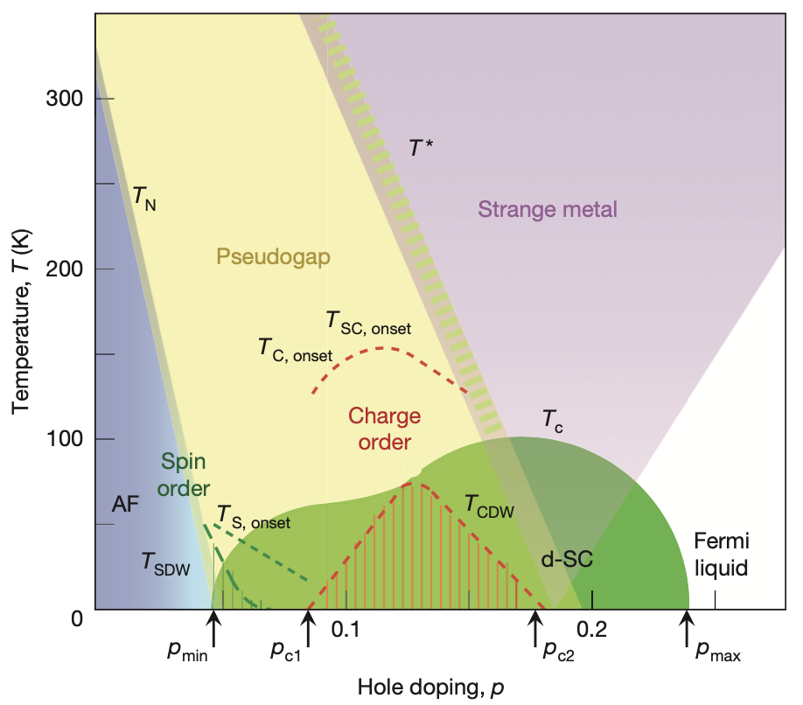
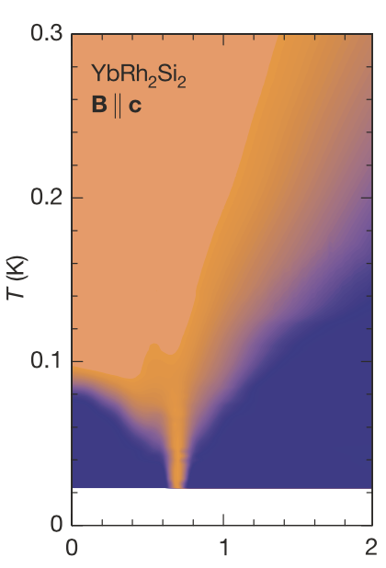
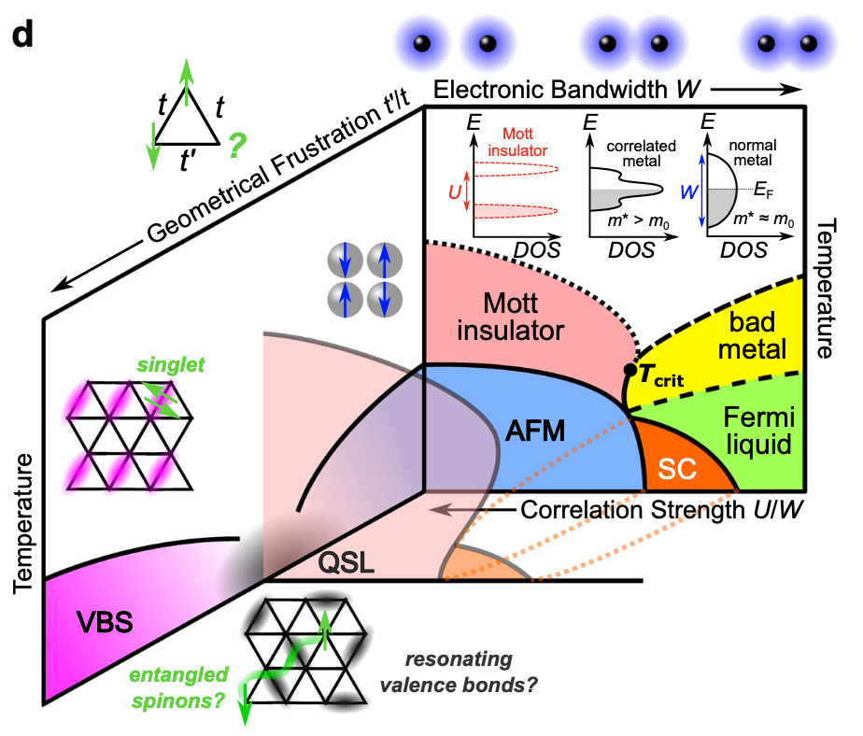
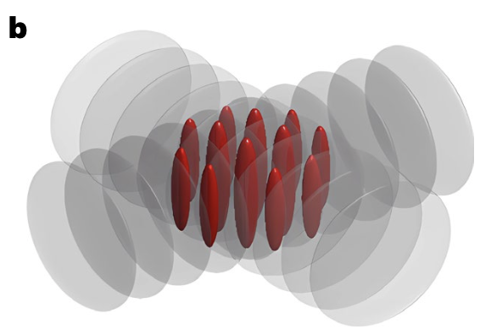
Fascinating physics from electron-electron interactions
High-T_{c} superconductivity, pseudogap
Quantum criticality/Strange metals
B. Keimer, et al., Nature (2015)
J. Custers, et al., Nature (2003)
Tseng, …, TS, Hansmann, SciPost Ph. ’25
Malcolms, …, TS, arXiv ‘24
Ortiz,…, TS, Hepting, PRR ‘22
Klett, …, TS, Front. Phys. ‘22
Kitatani, …, TS, Held, JPM ‘22
TS and Toschi, JPCM ‘21
Klebel-Knobloch, TS, …, PRB ‘21
Kitatani, TS, et al., PRB(R) ‘19
Gunnarsson, TS, et al., PRL ‘15
TS et al., PRL ‘17
TS et al., PRL ’19
Adler, …, TS, …, arXiv ’24
Kitatani, TS, …, arXiv ‘25
How can we treat such systems theoretically?
Mott metal-insulator transitions
“Artificial materials”/quantum simulators (cold atoms, moiré, …)
A. Pustogow, et al., Nat. Comm. (2023)
Menke, …, TS, PRL ’24
Meixner, …, TS, arXiv ‘25
Kowalski, …, TS, PRL ‘24
Meixner, …, TS, SciPost Ph. ‘24
Wagner, …, TS, …, Sangiovanni
Nat. Comm. ‘23
TS et al., PRX ‘21
Wietek, …, TS, Georges, PRX ‘21
Klett, …, TS, et al., PRR ‘20
TS et al., PRB ‘15
TS et al., JMMM ‘16
Y. Huo, …, H.-C. Nägerl, Nat. Phys. (2024)
Tscheppe, …, TS, PNAS ’24
D. Kiese, … TS, …, in preparation

Slide 4
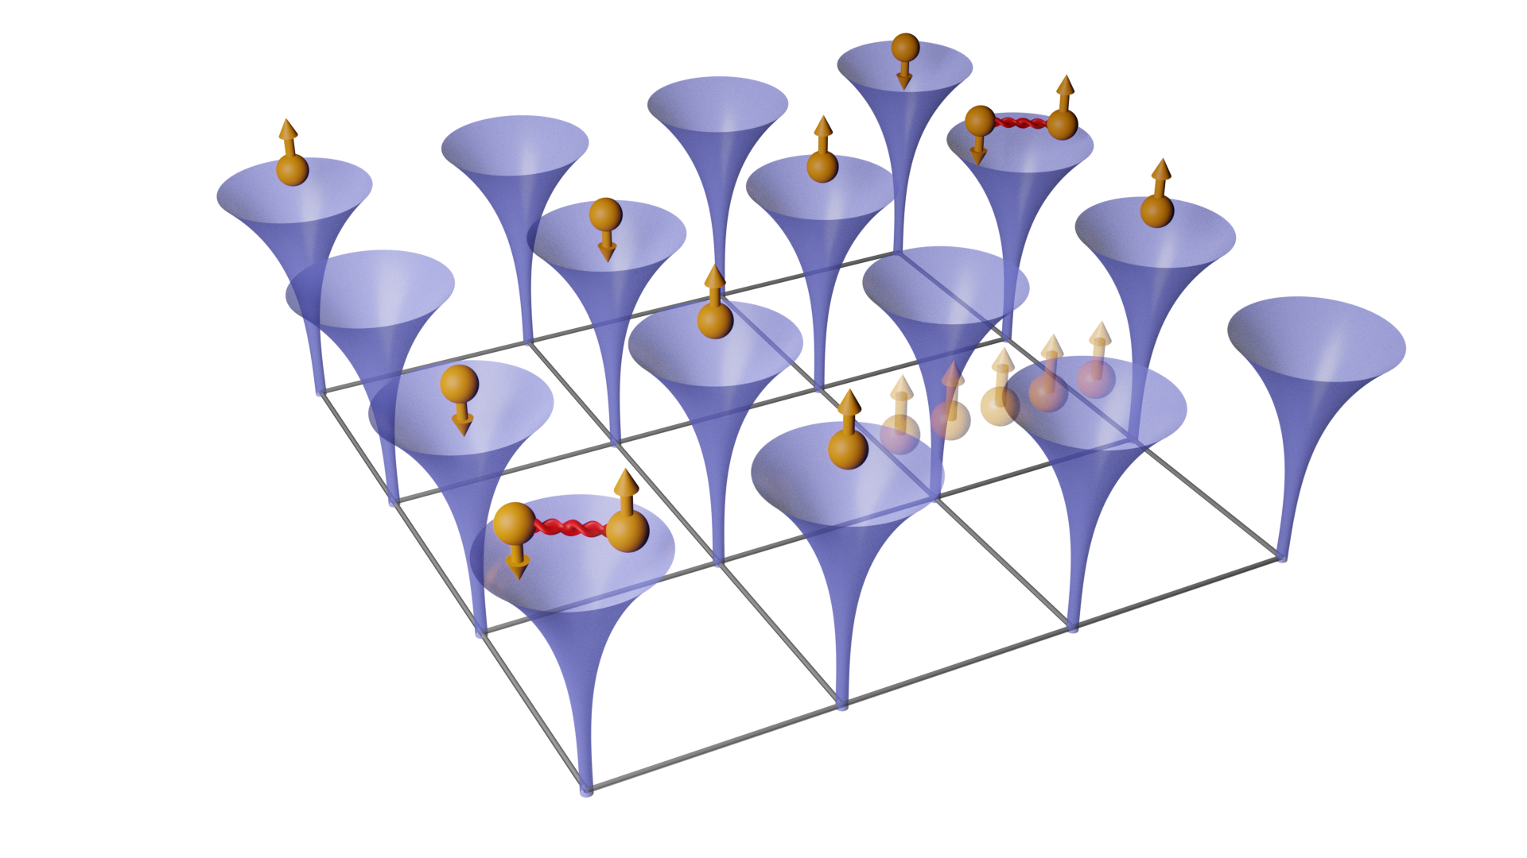
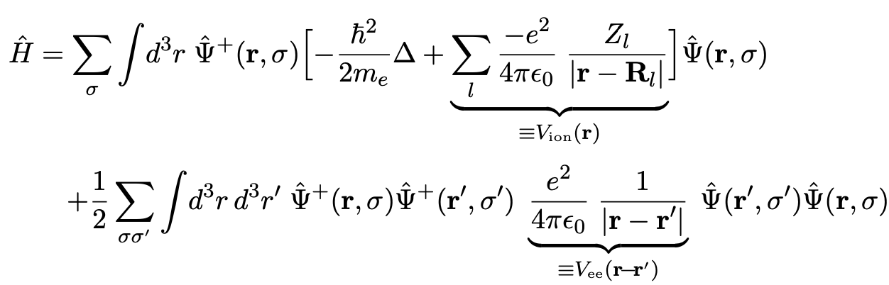
The full many-body (‘ab-initio’, solid-state) Hamiltonian
Problem: how can we treat a (quantum mechanical) system with 10²³ constituents?
Approximate solutions to H: density functional theory (DFT), perturbation theory, GW, etc.
Approximation to H: capture essential physics

Slide 5
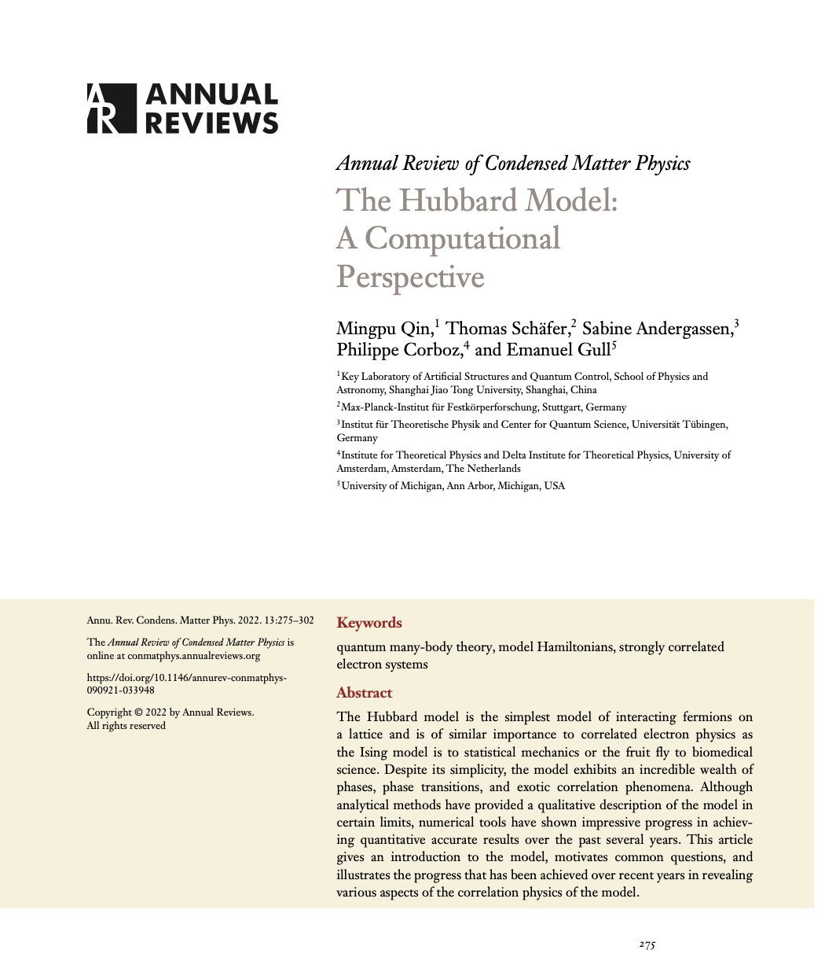
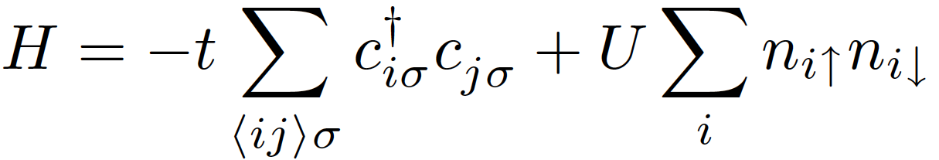
Interacting systems: fascinating physics - and a simple (?) modellization
Hubbard model
This model cannot be solved analytically in two and three dimensions! → numerical quantum many-body methods needed!
-t : hopping
U: local Coulomb
interaction
J. Hubbard, Proc. Royal Soc. A, 276, 238– 257 (1963)
M. Qin, TS, et al., „The Hubbard model – a computational perspective“, Annual Review of Condensed Matter Physics 13 (2022)

Slide 6
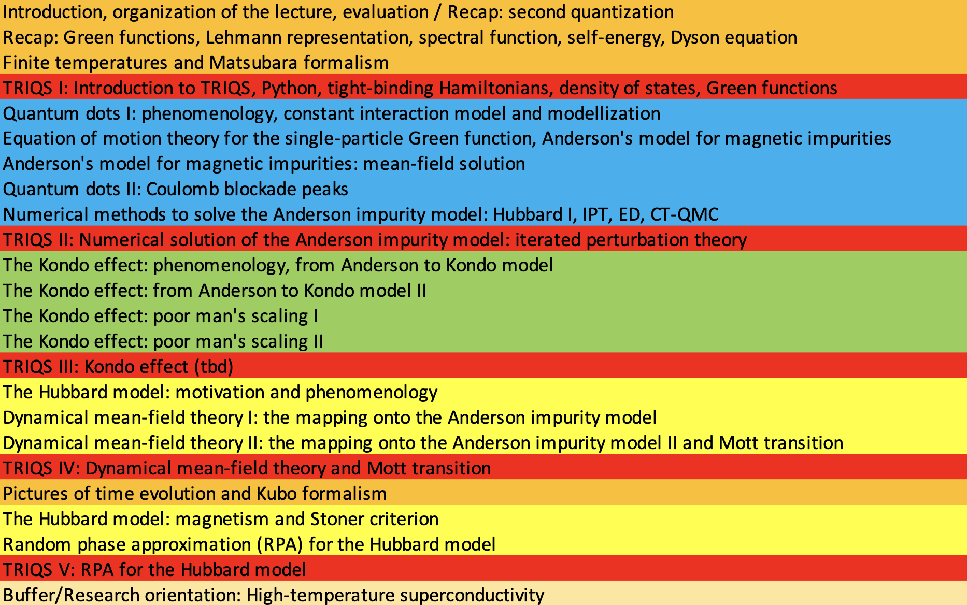
Tentative outline of the course
?

Slide 7

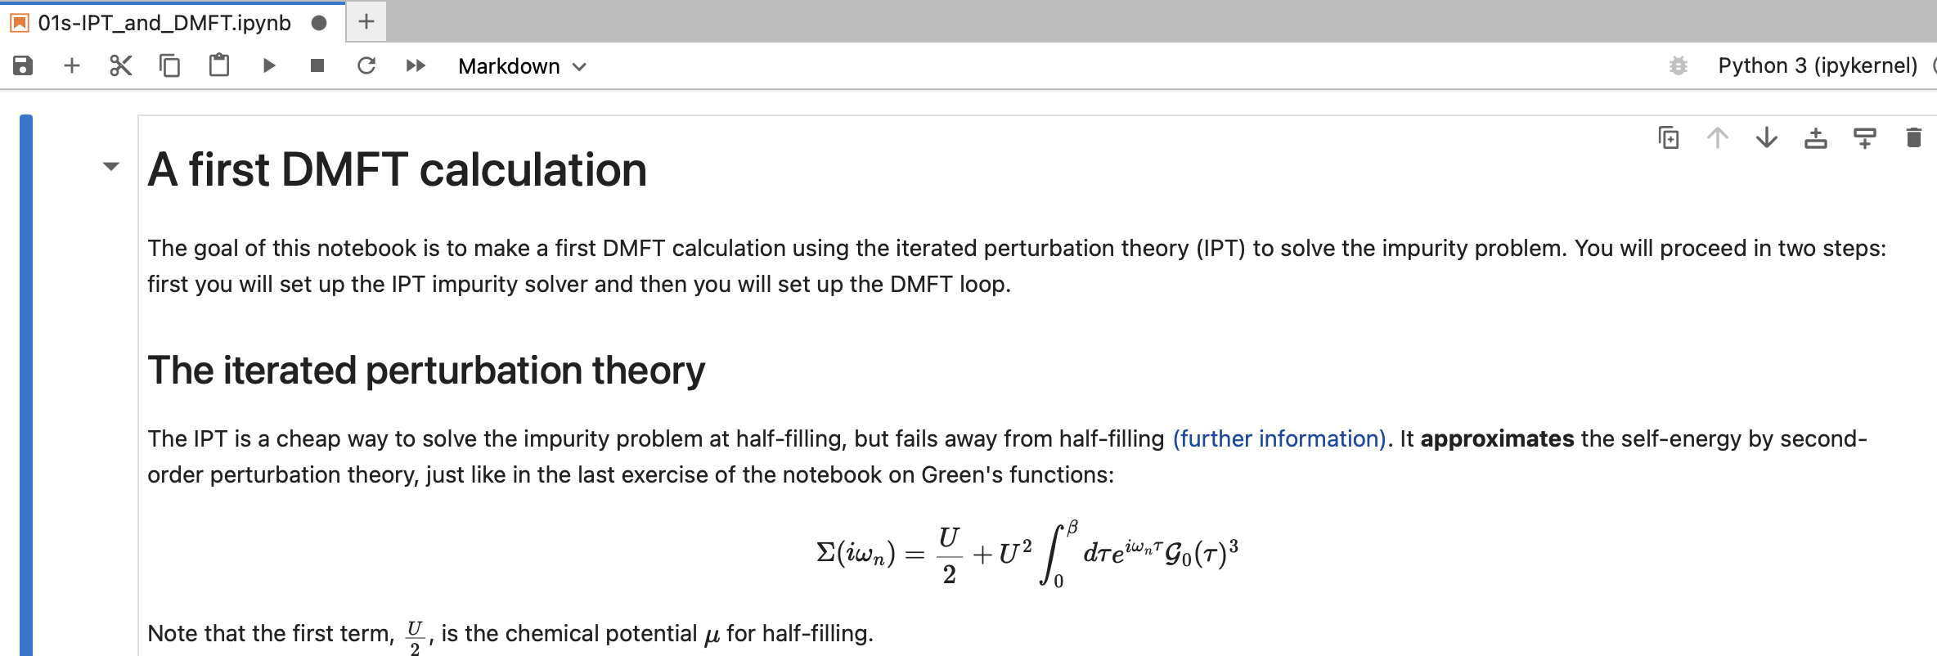
Numerical hands-on example sessions
Toolbox for Research on Interacting Quantum Systems
Introduction to topic and presented example (30 minutes)
Notebook to be worked on separately (40 minutes)
Presentation of solution (20 minutes)
LAPTOPS NEEDED!
https://triqs.github.io/triqs

Slide 8
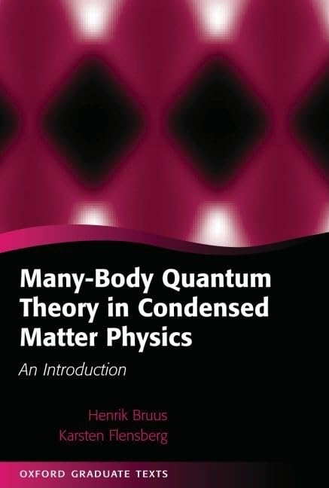
Course material
Lecture notes (blackboard and slides)
Numerical parts: notebooks
Book: H. Bruus and K. Flensberg “Many-body quantum theory in condensed matter physics” (Oxford Graduate Texts 2004)
Research papers and reviews (given in lectures)

Slide 9

Possible exam modi of the course
Students can chosse one of the following options:
Oral examination with two questions on the course from two different topics.
Presentation of a small numerical project worked out by the student and one question on the course.
Presentation of a current research publication by the student and one question on the course.

